Slide 1
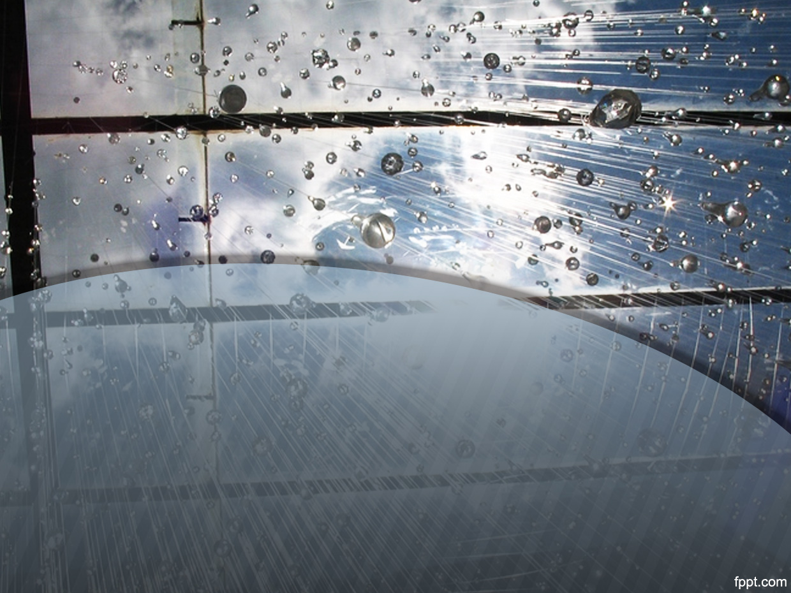
Rain Prediction
Name: Abu Naim Md Rabiul Hasan
Name: Sakif Obaid

Slide 2
Classification
Recurrent Neural Network approach
KNN Approach
Decision Tree
Random Forest
Combining all the algorithm by Meta-Regressor to give final prediction

Slide 3
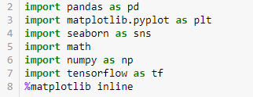
Libraries
Project is done on Jupyter notebook

Slide 4
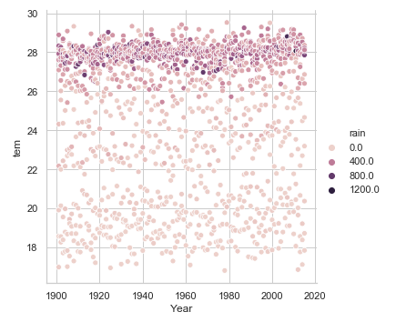
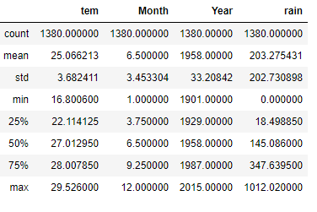
Dataset
Collected from kraggle
This dataset contains the monthly average value of Bangladesh temperature and rain from 1901 to 2015

Slide 5
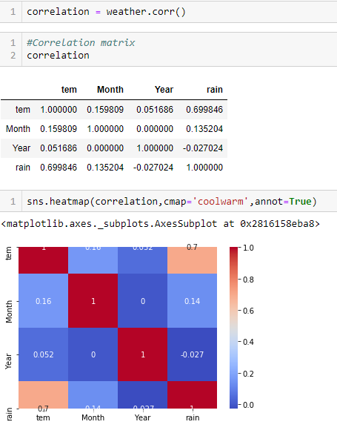
Correlation

Slide 6
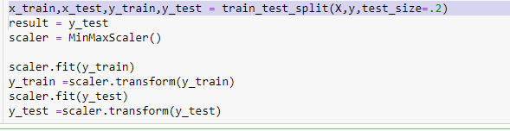
Preprocessing

Slide 7
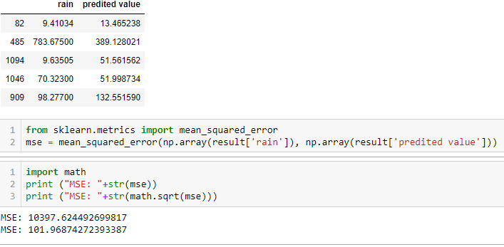
Using RNN Model
A recurrent neural network is a class of artificial neural networks where connections between nodes form a directed graph along a temporal sequence. This allows it to exhibit temporal dynamic behavior. Unlike feedforward neural networks, RNNs can use their internal state to process sequences of inputs

Slide 8
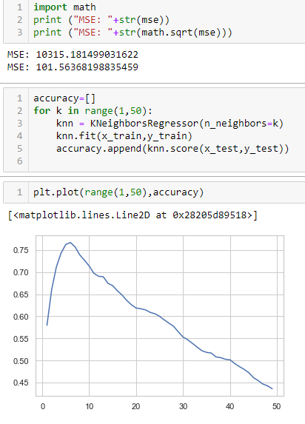
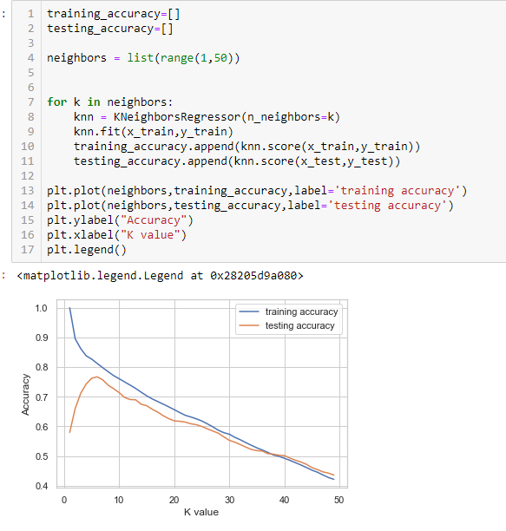
KNN Model

Slide 9
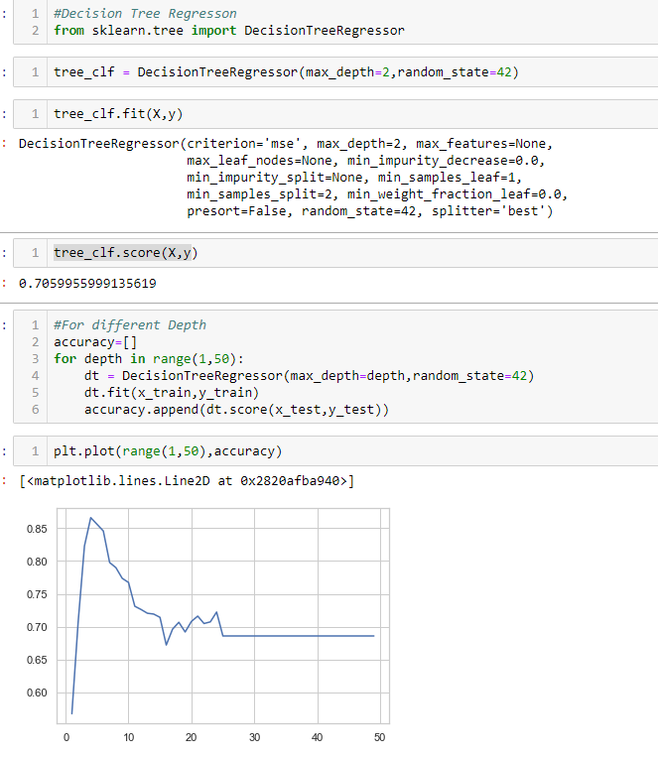
Decision Tree

Slide 10
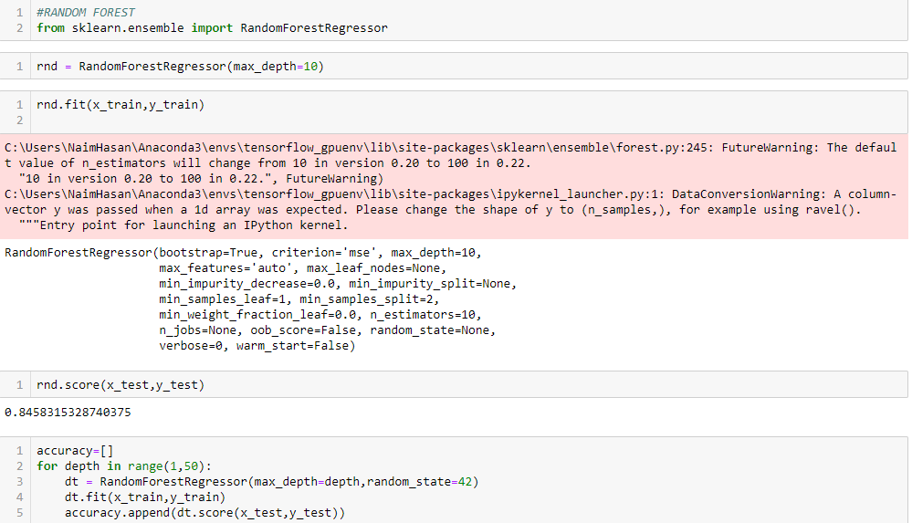
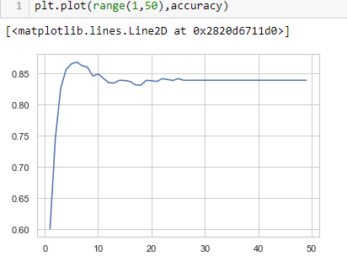
Random Forest

Slide 11
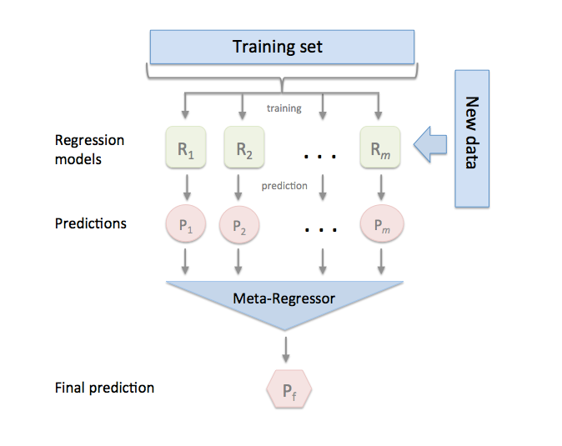
Combining all Algorithm

Slide 12
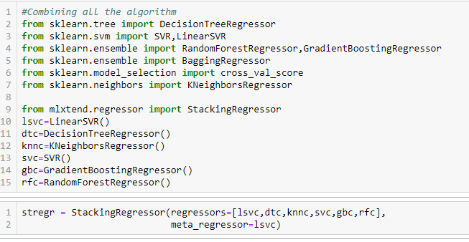
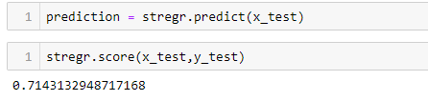
Combining all Algorithm

